Slide 1


Machine Learning
With python
EDA1: Exploring data
Model workflow, feature selection
Notes:
Layout objects pulled from: https://slidesgo.com/
All icons are from: https://thenounproject.com/

Slide 2
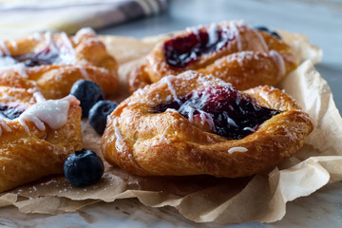

Warm-up
A stranger barrels up and shows you this picture of some blueberry pastries, saying “Can you help me? I want to make these but I don’t know where to start??”.
You’re flattered… and slightly terrified.
You don’t have time to teach a full baking masterclass, but you decide to drop just enough info so they can figure it out on their own and leave you in peace.
What do you say to them?

Slide 3
Colab workbook
Link: click for access
These are class notes. They’re never due, but helpful to have when completing homework and studying for standards.

Slide 4

Datasets This Week
Lecture
HW1 + Lab1
Palmer Penguins
link: github
Titanic
link: github

Slide 5

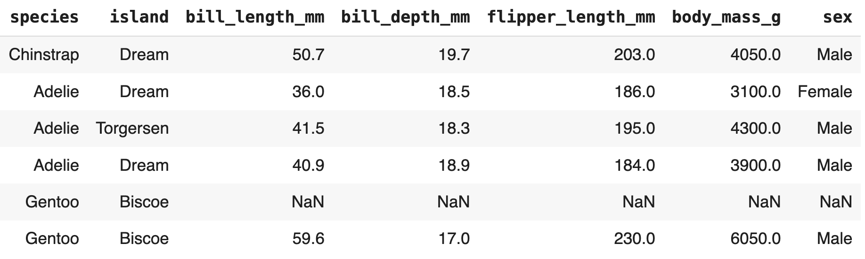
Exercise
Imagine you’ve just been handed a random sample of a dataset
What does all of this even mean? How do you suppose we go about working with this?

Slide 6
feature / attribute / column
target
feature set
class / label / ground truth
row / record / sample / instance
entry / value
Dataset Terminology

Slide 7
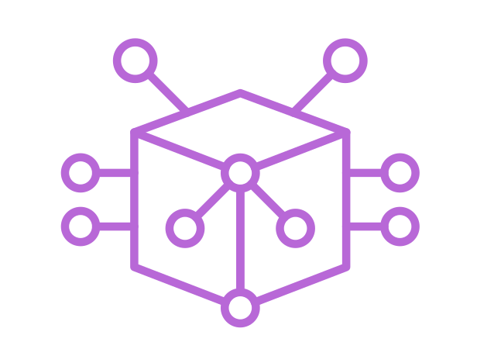
data
compared to evaluate how “good” the model did
labels
outputs of a model
features
data we use to build the model
target
correct output for a perfect model (supervised)
+
=
model
mathematical representation of the world
learning algorithm

Slide 8

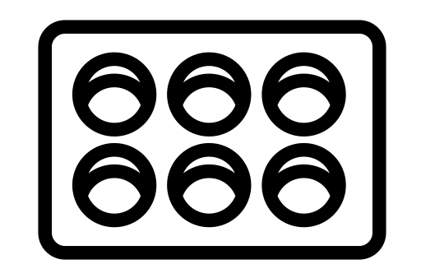





5 step machine learning Workflow or Baking the Cake
iterative process
exploring data (EDA)
Data cleaning
Model selection
Model training
Model evaluation
learning algorithm
model
data
tuning
1. exclude outliers from feature 3
2. refactor feature 2
3. balance feature 1
labels
target
feature 1
neural networks
feature 2
feature 3
linear regression
Ingredients
Recipe
Kitchen Gadget
Bake
Taste Test

Slide 9
5 step machine learning Workflow or Baking the Cake
exploring data (EDA)
statistical tests
distributions
missingness
outliers
correlations
visualizations
Data cleaning
feature engineering
one-hot encoding
standardization
transformation
class balancing
hash/embeddings
deal with missingness
Model selection
learning algorithm
hyperparameter tuning selection
training set
Model training
cross-fold validation
run models
dev set
Model evaluation
test set
accuracy
precision
recall
F1-score
confusion matrix
ROC or AUC
MSE or RMSE or MAE
tuning
feature 1
1. exclude outliers from feature 3
2. refactor feature 2
3. balance feature 1
neural networks
labels
target
linear regression
feature 2
feature 3
Ingredients
Recipe
Kitchen Gadget
Bake
Taste Test

Slide 10
Supervised
Teach model to give accurate predictions on new unseen data
Labeled data (has target)
Classifying images
Language translation
Predicting housing prices
Object detection
Classifying mushrooms as poisonous/edible
Unsupervised
Teach model to discover groups and patterns
Unlabeled data
Clustering
Outliers
Denoising signals
Topic modeling
Recommender systems
Dimensionality reduction
Grouping mushrooms by characteristics
Reinforcement
Teach an agent about the world by rewarding good behavior
go/chess
generative design
predator/prey
Supervised: Classification
Unsupervised: Clustering
Reinforcement

Slide 11
Model Selection Flowchart
Unsupervised: Dimensionality Reduction
Need to reduce dimensionality?
Y
Unsupervised: Clustering
N
N
Has a Target Variable?
Y
Supervised: Classification
Supervised: Regression
N
Y
Predicting a Numeric Value?

Slide 12
So what can you do with penguin data? Grab a partner, and spend five minutes creating an idea for each of the model types below. Once your group has this filled out, add your ideas to a board (each person does an approach)
Supervised Regression
Target variable:
Feature set:
Model rationale:
Unsupervised Clustering
Target variable:
Feature set:
Model rationale:

Slide 13
No free lunch
No single algorithm can solve all problems
Algorithm choice has consequences
Important to know pitfalls to help mitigate bias

Slide 14
Why learn all of this when genAI exists?
Need to know foundations in order to understand how model can generate new data from learned patterns
Understand complex architectures
Interpretability, bias, and ethics
Appropriate applications

Slide 15
feature types can be…
Categorical: finitely many values
Ex: animals: dog, cat, iguana
Ordinal: categorical, but with natural order
Ex: sizing: small, medium, large
Numerical: numeric values
Ex: quiz scores: 7, 24, 35
Continuous: real numeric values (decimal)
Ex: weights of hamsters: 4.23, 3.2
Binary: two options (usually 0 and 1)
Ex: sex: Male, Female
categorical
numeric
categorical
continuous
discrete
binary

Slide 16
PassengerId, Survived, Pclass, Name, Sex, Age, SibSp, Parch, Ticket, Fare, Cabin, Embarked
Numerical
Categorical
Binary
Continuous
Ordinal
None
use titanic data to group feature types

Slide 17
Machine Learning
With python
EDA2: Exploring data
Statistics: descriptive, distributions, tests
Notes:
Layout objects pulled from: https://slidesgo.com/
All icons are from: https://thenounproject.com/

Slide 18
Colab workbook
Link: click for access

Slide 19
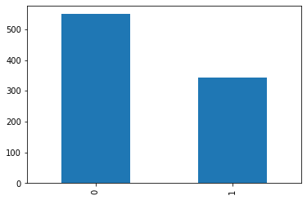
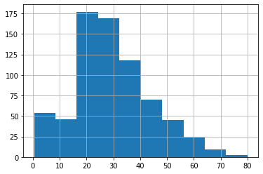
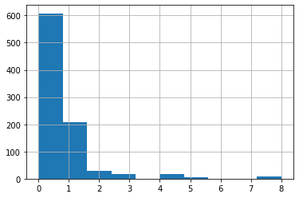
Warm-up
For each of the following plots, describe what you see. Use relevant statistical terminology if you can remember it.
In your own words, describe mean, median, mode, and standard deviation.
What are methods used to see whether there are differences among groups?

Slide 20
What should we be on the lookout for?
numerical
categorical
are distributions normal or skewed?
balanced or unbalanced?
which categories could be combined?
any features needing transformation?
balanced
unbalanced
too many
normal
left skew
right skew
which categories underrepresented?
some algorithms do poorly on skewed data, so we usually transform these during data cleaning
should sampling occur?

Slide 21
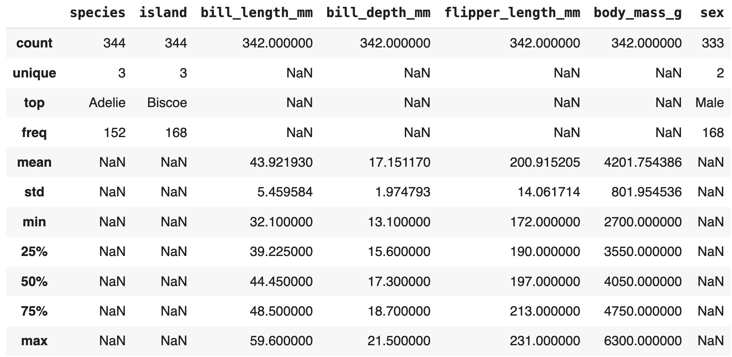
To see a table of common statistics for all features we can use describe!
penguins.describe(include= 'all')
this includes both categorical and numeric features

Slide 22
numerical features
balancing point of distribution
spread
smallest value of data
middle value of data
largest value of data

Slide 23
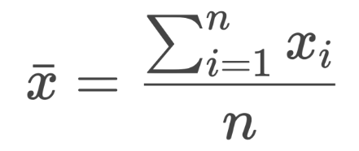
Descriptive stats: numerical features
add your answers to your workbook
Example 1: Five employee salaries at a small start-up:
$33k, $35k, $35k, $37k, $210k
Find mean:
Find median:
Mean: the balancing point of the data
Median: middle of ordered data, also called the 50th percentile
=
sum of all records
number of records
sample size
$33k+$35k+...+ $210k = $70k
5
$35k
If mean and median are quite different from each other, then the data is skewed.
When median < mean the distribution is right skewed. If median > mean, then left.
If significantly << or >>, then add a very in front. e.g. 35k<<70k → very right skewed.

Slide 24

Descriptive stats: numerical features
add your answers to your workbook
Example2: For the following two scenarios, give a list of six numbers chosen from the set: 0, 1, 2, 3, 4, 5 (repeats are ok)
Scenario1: Six numbers with smallest possible standard deviation
Scenario2: Six numbers with largest possible standard deviation
Standard deviation: (approximately) the average distance of the data from the mean, also called spread.
All numbers are the same → s=0
Set: 4, 4, 4, 4, 4, 4
when s = 0, then no variability
Numbers equally on far ends
Set: 0, 0, 0, 5, 5, 5

Slide 25
Descriptive stats: numerical features
Kth percentile: data value s.t. k% of the data is less than or equal to that value
Quartiles: special percentiles that split the data into quarters
First quartile Q1: 25th percentile
Second quartile Median: 50th percentile
Third quartile Q3: 75th percentile
Ex: If you scored in 34% percentile in reading in the 3rd grade, then your score was better than 34% of the other 3rd grade students

Slide 26
Here is how we could order the following columns from:
most left skewed (mean<median) to most right skewed
bill_length bill_depth flipper_length body_mass
very left skewed
balanced
very right skewed
body_mass
bill_length
bill_depth
flipper_length

Slide 27
Categorical features
number of records
number of categories
top category
count in top category

Slide 28
Descriptive stats: categorical features
Let’s talk about some things to keep an eye out for when looking at these features
If unique > 5-8. We usually convert categorical columns to binary columns, each column being a unique category.
Too many categories => lots of columns => dimension increases.
Solution: consolidate to 5 or less categories.
If top frequency >> average count. Want each category to have similar counts, this is called balanced.
Too many records of single category (unbalanced) means low diversity in training models => overfitting/underfitting problem
Solution: up/down sample accordingly.

Slide 29
Discuss the categorical features. Which are balanced vs unbalanced.
unbalanced
balanced
island
species
sex

Slide 30
statistical tests
t-test
Determines difference in means between two categories
chi-sq
Determines association between two features
categorical
numerical
categorical
categorical
H0: there is no difference in average body mass among Chinstrap and Gentoo species
H0: there is no association between penguin species and islands
ANOVA
Determines difference in means between two+ categories
categorical
correlation
Determines linear relationship between two features
numerical
numerical
numerical
H0: there is no difference in average body mass among all three penguin species
H0: there is no linear relationship between bill length and bill depth

Slide 31
Hypothesis testing
H1: there is a significant difference between average body mass among two penguin species
Trying to find enough evidence to disprove a statement
The statement we’re trying to disprove is called our null hypothesis, H0. The alternative is H1.
H0: there is no difference between average body mass among two penguin species
The first bit of evidence we’re collecting is a test statistic. The test we use is determined by the type of features being compared.
We have one numeric feature and one categorical feature, so we use a t-test.
Note: missing values will need to be removed for testing purposes

Slide 32
Hypothesis testing
What’s considered small? Typically between 0.01 and 0.005, sometimes 0.05. Depends on the application.
Trying to find enough evidence to disprove a statement
The second bit of evidence we’re collecting is a p-value, which tells us how likely it is to see a test statistic more extreme than the one we calculated. If small, then statistically significant.
If we run the test and get a small p-value, then we reject the null and conclude there is a significant difference in the body mass of penguin species. If p-value isn’t small, cannot reject the null (inconclusive)
If significant, then need to further explore to unpack what’s happening as p-value isn’t enough evidence.
If significant, create some visualizations to see what is going on.
goal of this next step is to collect more evidence around the claim that something is indeed significant.

Slide 33
The misconception about p-values
What they actually measure. It’s evidence that we see a given value assuming the null is true. If small chance to see that value, we reject the null. We’re not saying it’s not true, just very unlikely.
Why the definition of ‘small’ changes. Depending on the context, it may be catastrophic if you reject something based on an arbitrary threshold. On the other hand, some folks pick a certain threshold so their results become significant. This is called p-hacking and is problematic as it undermines valid research practices.
What to do next. p-values are just one piece of evidence. Gather more by doing other stats (confidence intervals, sample size) and visualizations (boxplots, histograms, heatmaps)
More info pls. ASA has great advice on how to interpret p-values (link here).
Note: To do HW1 #4 you’ll need to know which viz to do (we’ll learn this next time!)

Slide 34
Interpret the statistical tests in your colab workbook by filling in the blanks. Some of the notes here may be helpful.
t-test: determines difference in means between two categories
H1: there is a significant difference between average body mass among penguin species
ANOVA: determines difference in means between two+ categories
H0: there is no difference between average body mass among penguin species
chi-sq: determines association between two categorical features
If we run the test and get a small p-value, then we reject the null and conclude there is a significant difference in the body mass of penguin species. If p-value isn’t small, cannot reject the null (inconclusive)
correlation: determines linear relationship between two numeric features

Slide 35
Quiz INTRO
We’ll continue content at 1:50. Spend ~5 minutes on each page, adding explanation where needed.

Slide 36
Homework work time
HW1
Let’s get a start on some more homework questions. Grab a partner to get started. If you have any questions on finding the dataset please let me know!
View on our website

Slide 37
Machine Learning
With python
EDA3: Exploring data
Visualizations
Notes:
Layout objects pulled from: https://slidesgo.com/
All icons are from: https://thenounproject.com/

Slide 38
Colab workbook
Link: click for access

Slide 39
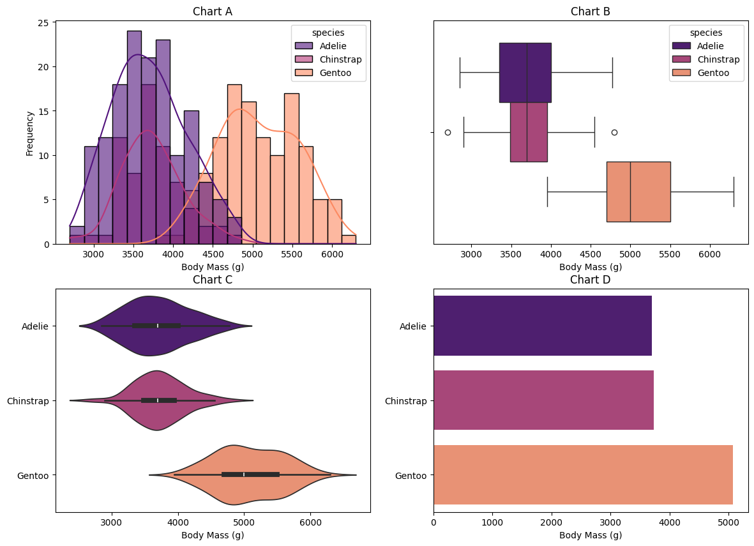
Warm-up
Each of the following visualizations compares body mass across penguin species.
For each chart, describe what it does well, and what it could improve upon.
Consider things like statistical measures, visual appeal, informativeness, etc.
Lastly, come up with an informative and appealing title for each chart.

Slide 40
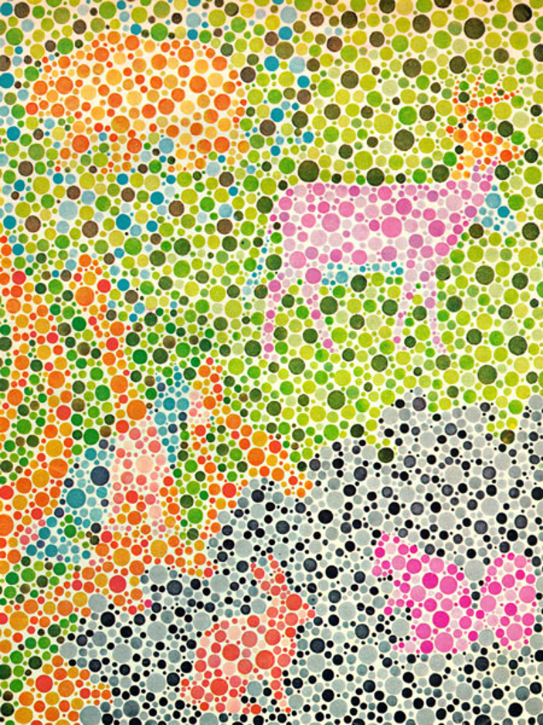
sim daltonism link
photo by Field and Stream magazine

Slide 41


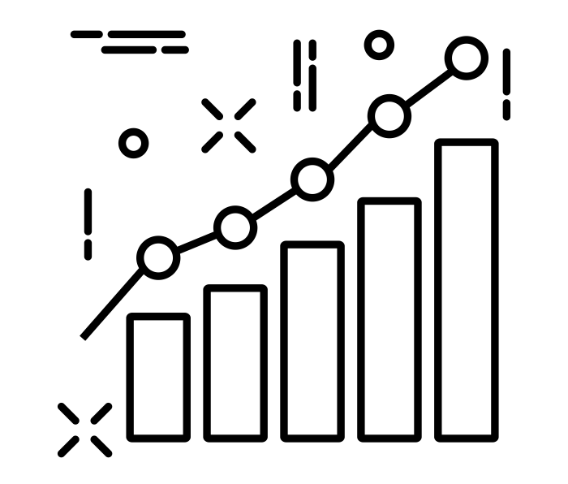
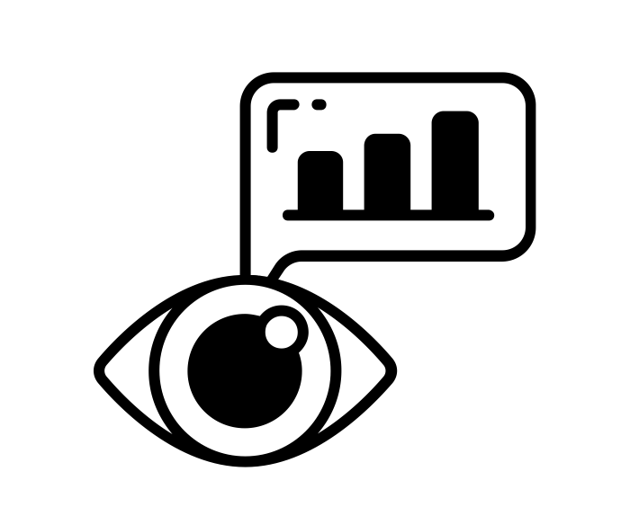

Visualizations
top 10 dos and don’ts reading: link
how to use colors in visualizations video (link)
Impactful visuals leads to better insights
Better insights leads to more informed decisions
tell a story
color matters
…so how do we create impactful visualizations?
avoid cognitive overload
experiment!
simple but rich

Slide 42
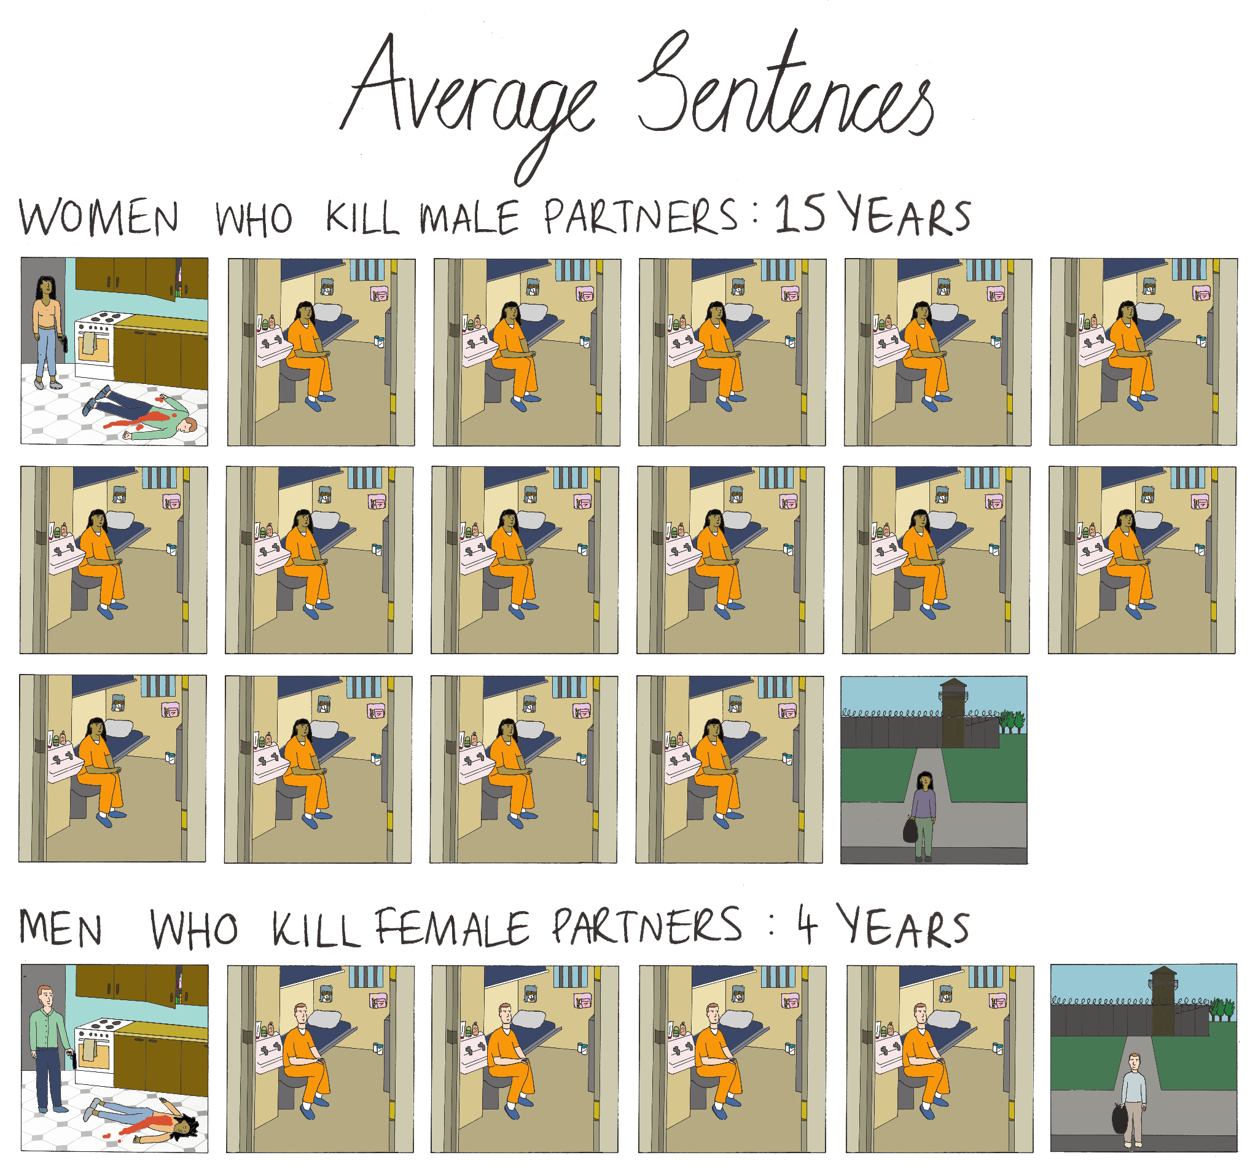
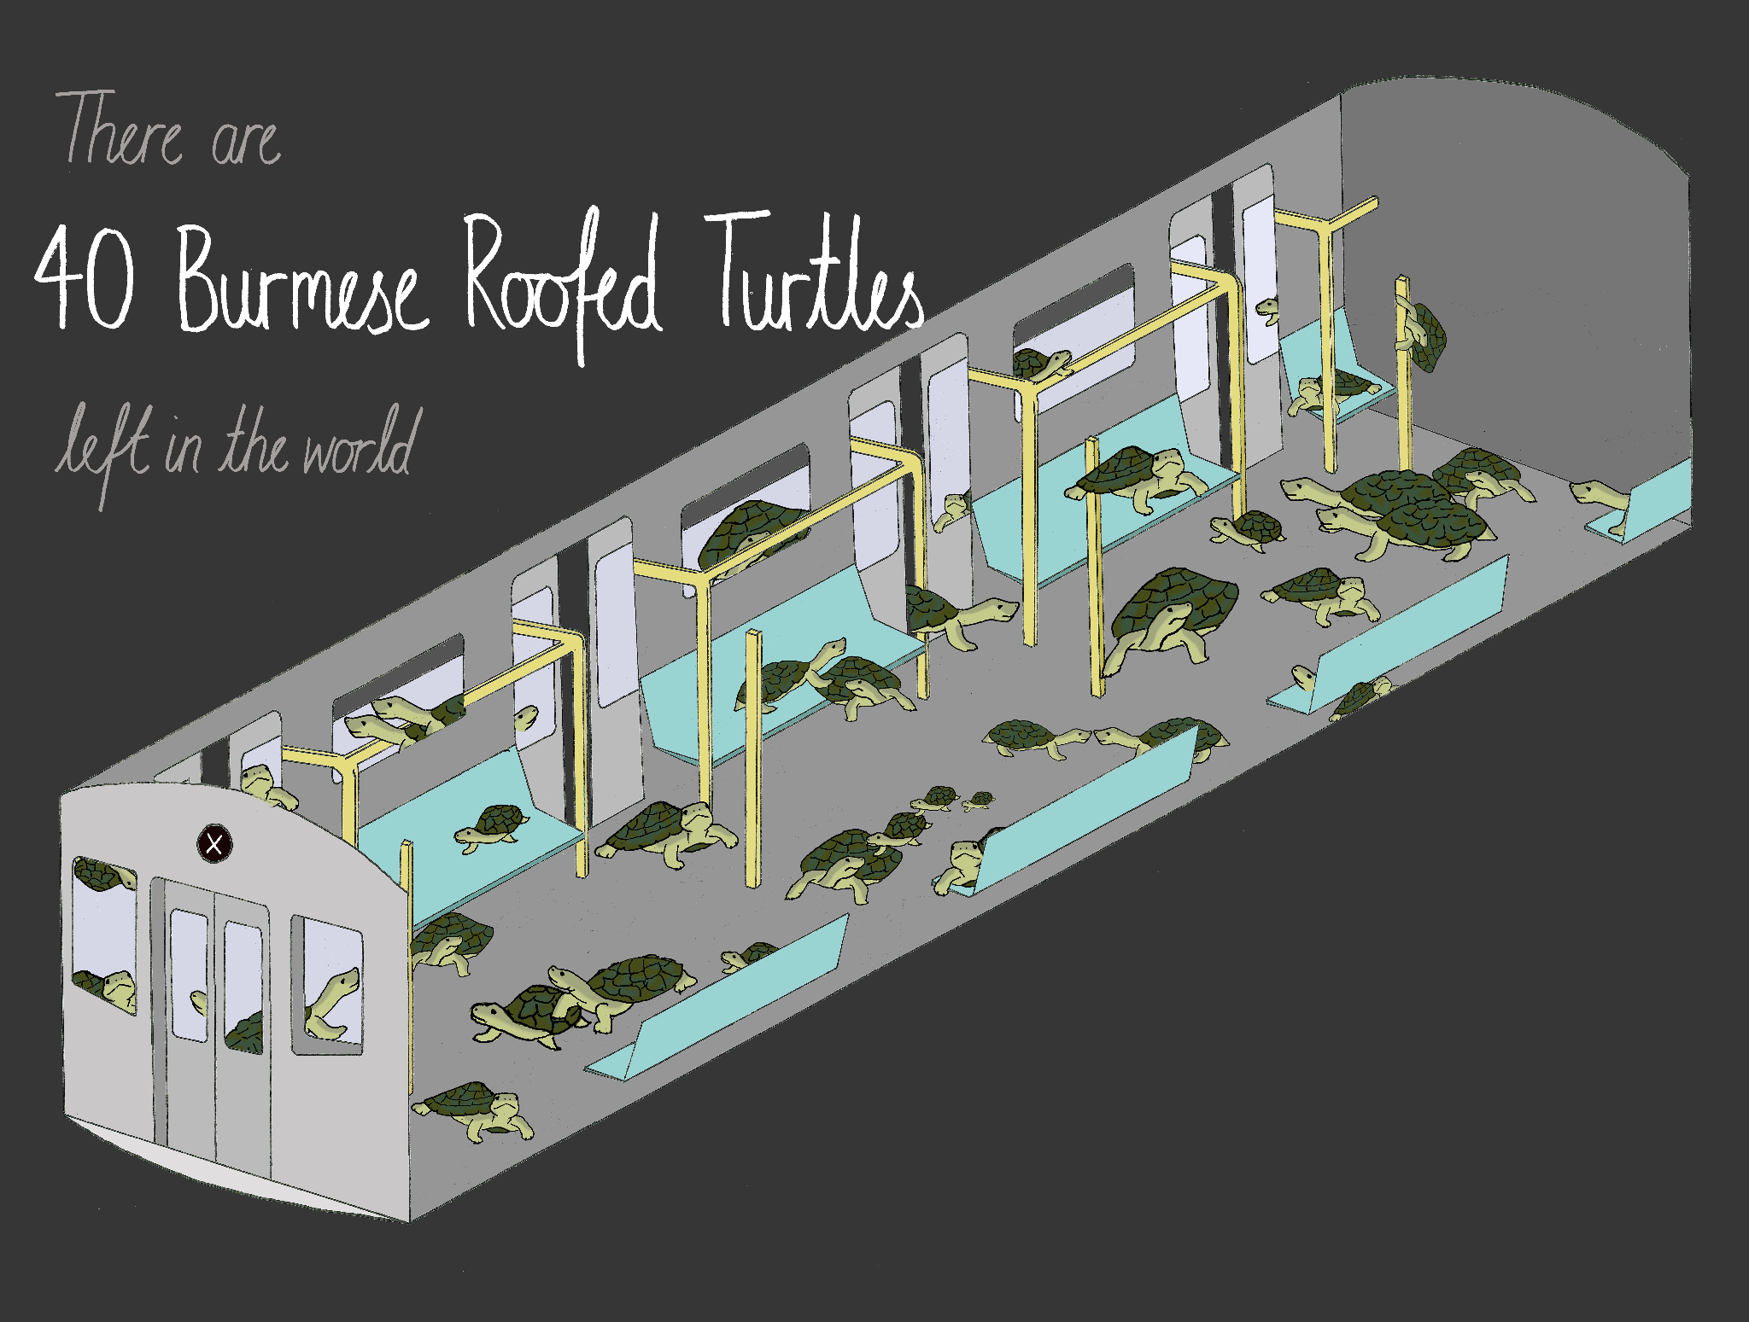
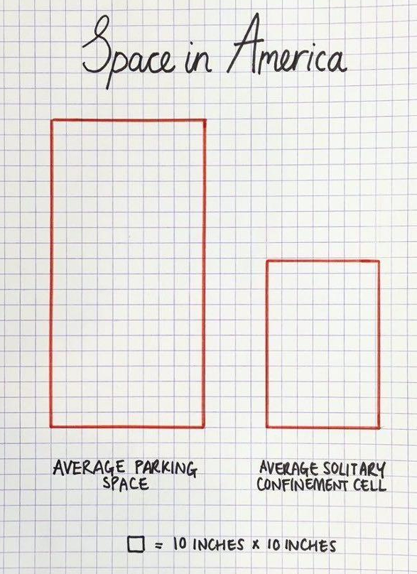
Visualizations
Sketching with Data with Mona Chalabi (link)

Slide 43
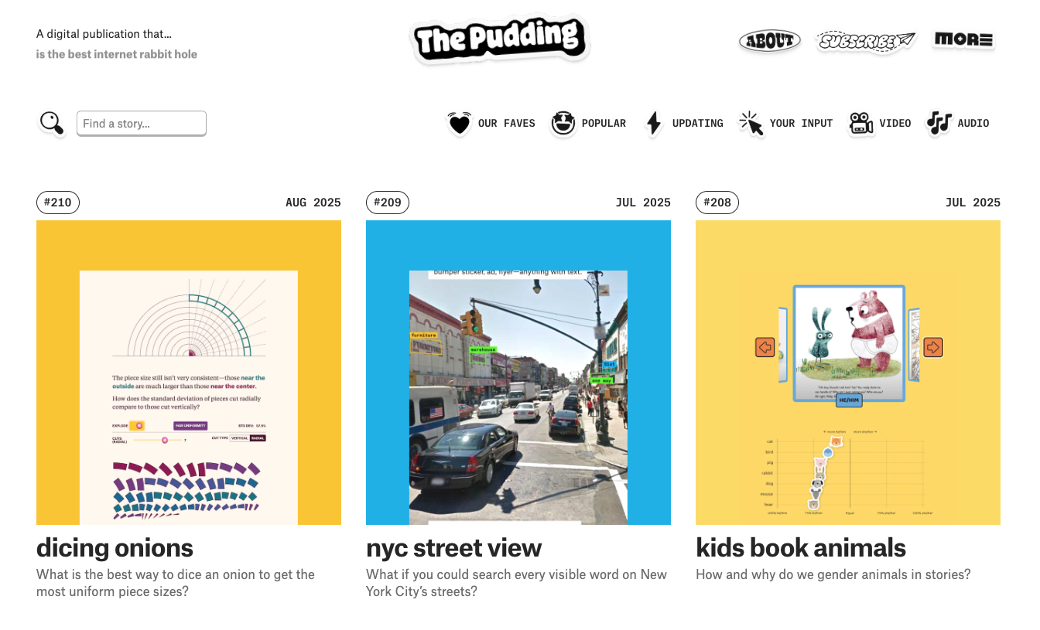

Exercise
Visit The Pudding (pudding.cool) and explore some stories.
Take note of the visual cues they use.
What makes the visualizations or charts nice to look at?
What narrative do they use to help you understand the story being told?

Slide 44
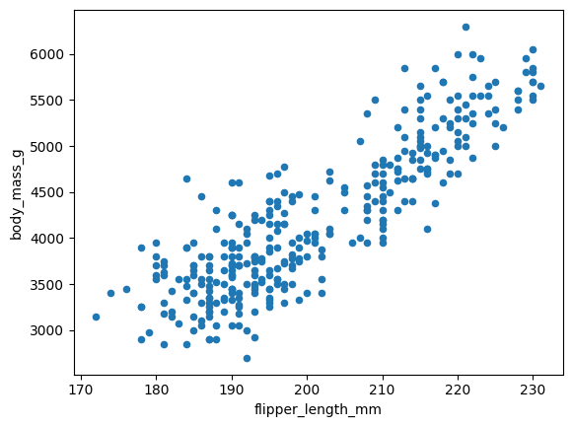
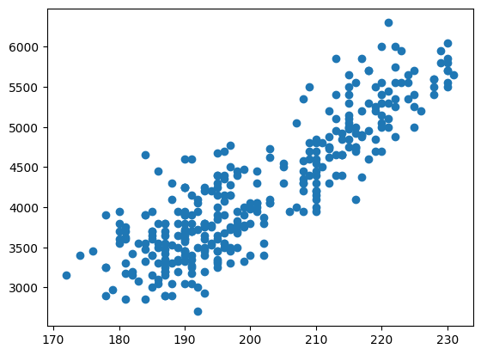
plot
documentation
matplotlib
documentation color names
penguins.plot(kind = "scatter",
x= "flipper_length_mm",
y = "body_mass_g")
plt.scatter(penguins["flipper_length_mm"],
penguins["body_mass_g"])

Slide 45

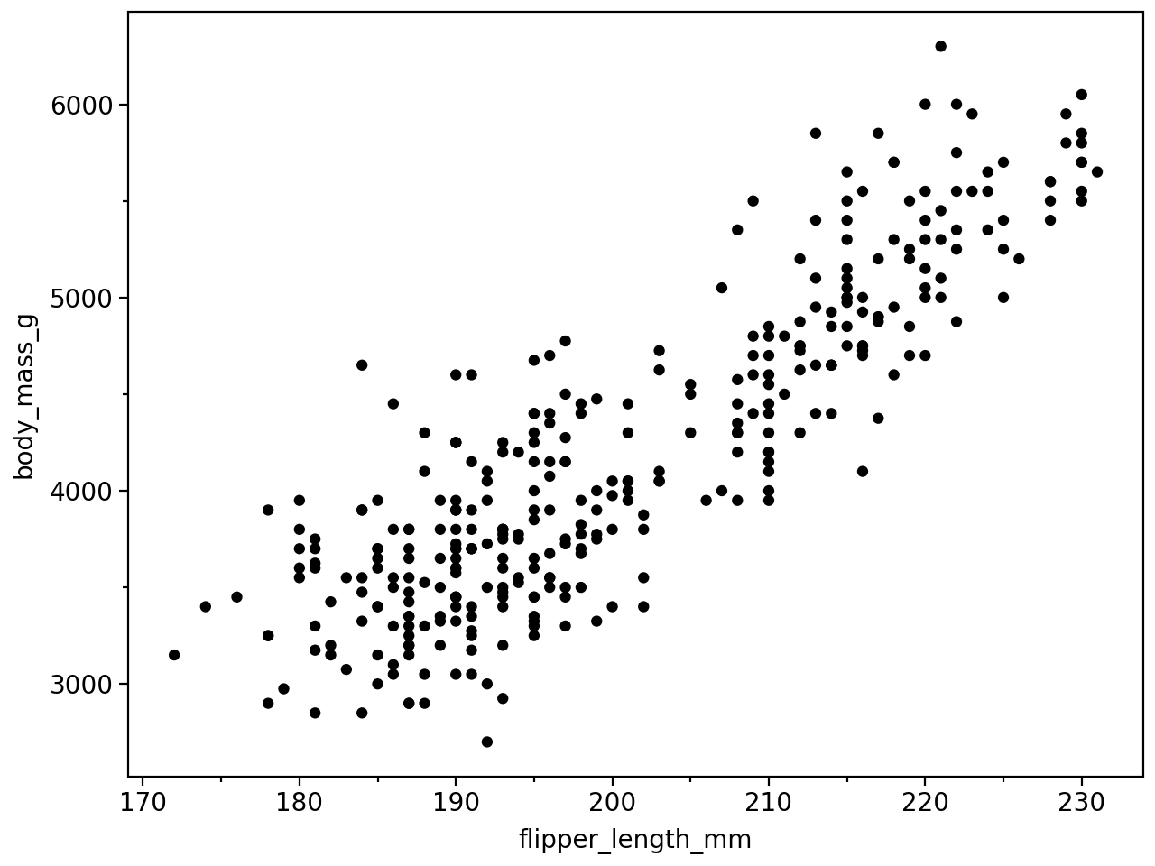
seaborn
documentation
plotnine
documentation
sns.scatterplot(data = penguins,
x = "flipper_length_mm",
y = "body_mass_g")
(ggplot(penguins,
aes("flipper_length_mm", "body_mass_g"))
+ geom_point()
)

Slide 46
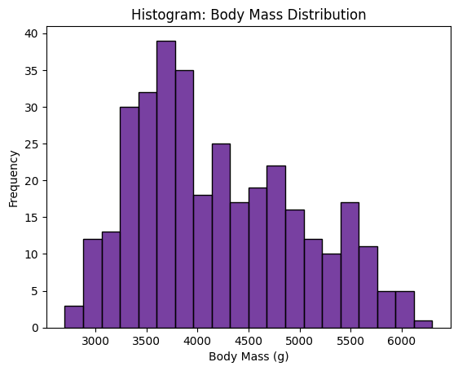
Univariate → single feature
Histograms show distribution and skewness of a continuous feature
sns.histplot(data=penguins,
x='body_mass_g',
color='indigo',
bins=20)
plt.title('Body Mass Distribution')
plt.xlabel('Body Mass (g)')
plt.ylabel('Frequency')
more bins = smaller binwidth
less bins miss details, but
more bins prone to noise
take
note
symmetry vs skewness; modality; clumps or gaps
penguins['body_mass_g'].plot(kind='hist', bins=20,color='indigo', edgecolor='black')

Slide 47
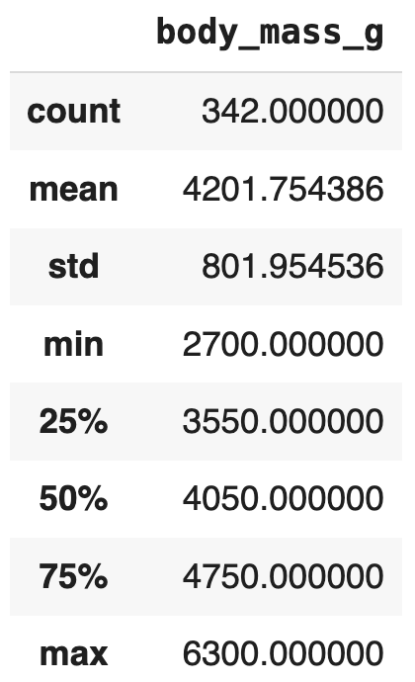
Sometimes it’s best to see a table of common statistics of a numeric features rather than creating a visualization
penguins['body_mass_g'].describe()
Notice 50% percentile is slightly less than the mean.. This means it is skewed to the _______
right

Slide 48
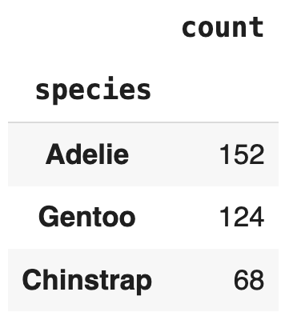
Sometimes it’s best to see a table of the distribution of a categorical feature rather than a visualization
penguins['species'].value_counts()
When value counts are roughly the same for each category this is called balanced.
Highly unbalanced data is less ideal for ML outcomes.
Would you consider the species feature to be balanced or unbalanced?
Mode: category/ies with highest value count

Slide 49
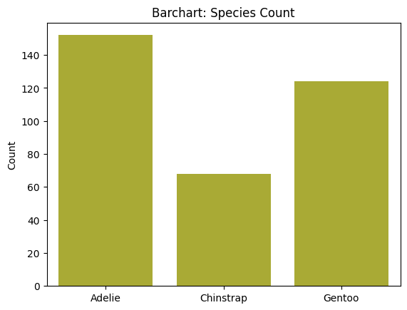
Univariate → single feature
Barcharts show counts within a categorical feature
sns.countplot(data=penguins,
x='species',
color='tab:olive')
plt.title('Barchart: Species Count')
plt.xlabel(None)
plt.ylabel('Count')
axes should be scaled correctly
not cluttered: 3-5 categories good, anymore may require you to combine smaller categories together OR use color only on important categories
take
note
balanced vs unbalanced; appropriate axes
penguins['species'].value_counts().plot(kind='bar', x='species', y='count', color='tab:olive')

Slide 50
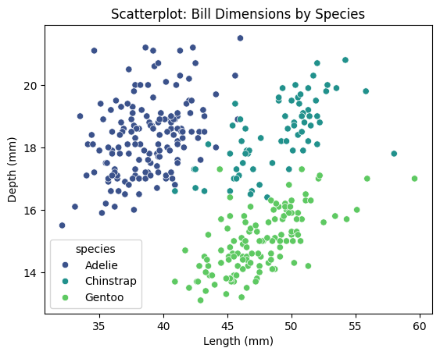
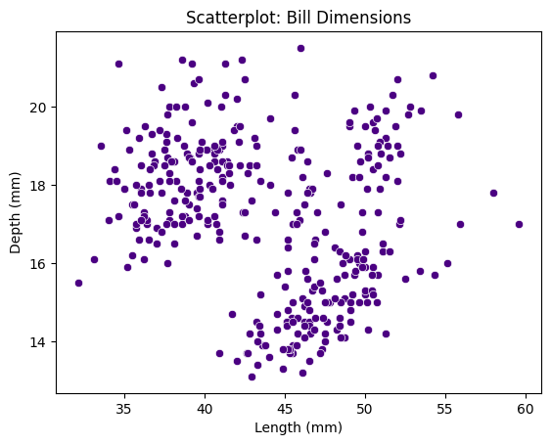
Bivariate → two features
Scatterplots show correlations between two continuous features
sns.scatterplot(data=penguins,
x='bill_length_mm',
y='bill_depth_mm',
hue = 'species',
palette='viridis')
plt.title('Bill Dimensions by Species')
plt.xlabel('Length (mm)')
plt.ylabel('Depth (mm)')
sns.scatterplot(data=penguins,
x='bill_length_mm',
y='bill_depth_mm',
color = 'indigo')
plt.title('Scatterplot: Bill Dimensions')
plt.xlabel('Length (mm)')
plt.ylabel('Depth (mm)')
relatively small data, somewhat linear
y
x
color
depth
length
species
take
note
correlation != causation
penguins.plot(kind='scatter', x='bill_length_mm', y='bill_depth_mm', color='indigo')

Slide 51
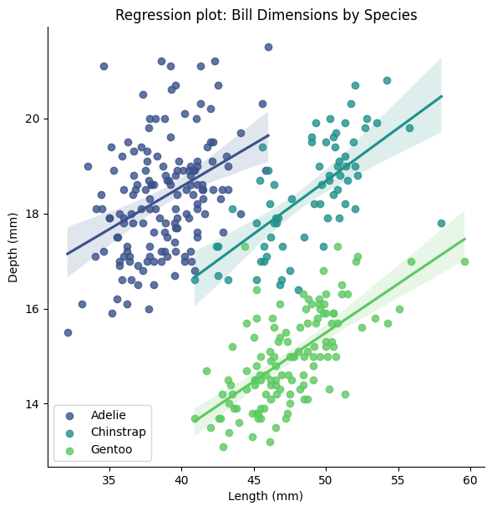
Multivariate → 3+ features
Regression plots show correlations between two continuous features and fit a line of best fit
sns.lmplot(data=penguins,
x='bill_length_mm',
y='bill_depth_mm',
hue="species",
palette='viridis',
legend=None, height=6)
plt.legend(loc='lower left', ncol=1)
sns.scatterplot(data=penguins,
x='bill_length_mm',
y='bill_depth_mm',
color = 'indigo')
plt.title('Scatterplot: Bill Dimensions')
plt.xlabel('Length (mm)')
plt.ylabel('Depth (mm)')
y
x
color
depth
length
species
take
note
correlation != causation
here, bill depth and length are positively correlated as we can see from the positive line

Slide 52
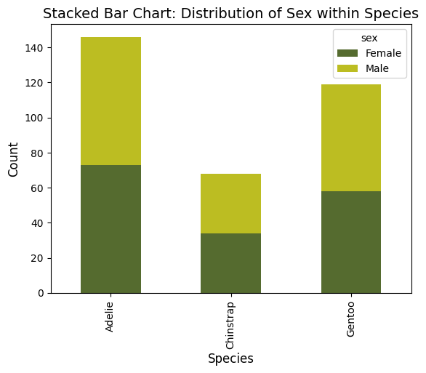
Bivariate → two features
Stacked barcharts compare two categorical features
pivot_data = penguins.pivot_table(index='species',
columns='sex',
aggfunc='size',
fill_value=0)
pivot_data.plot(kind='bar', stacked=True,
color= ['green', 'tab:olive'])
y
x
color
count
species
sex
take
note
difficult to compare sizes (not exact)

Slide 53
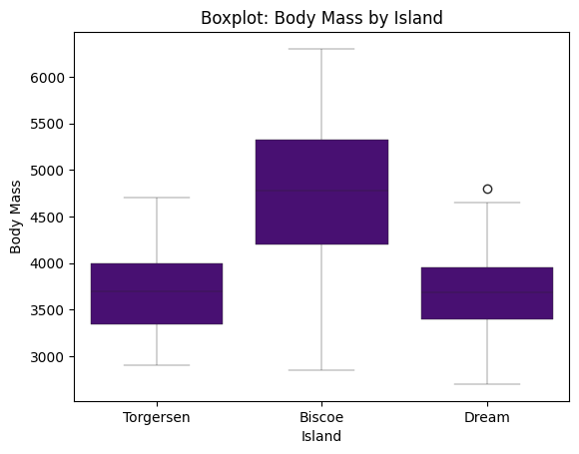
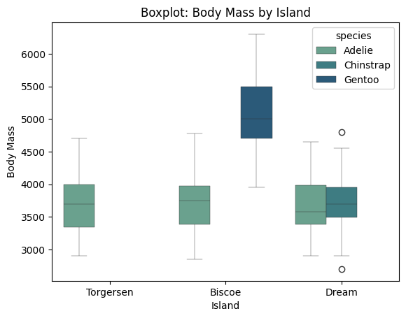
Boxplots compare the distribution, skewness, and/or outliers of a single numerical feature to 0+ categorical features
sns.boxplot(data = penguins, x = 'island',y ='body_mass_g',
hue = 'species', palette = 'crest', linewidth=0.3)
sns.boxplot(data = penguins, x = 'island',y ='body_mass_g',color = 'indigo',linewidth=0.3)
y
x
color
body mass
island
species
take
note
requires interpretation and needs categorical feature to compare with

Slide 54
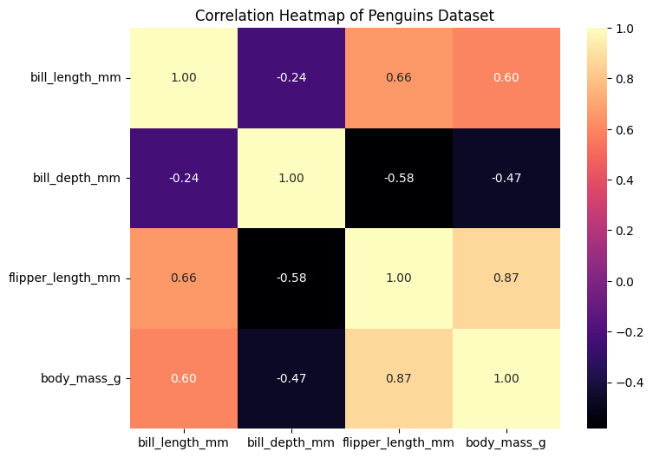
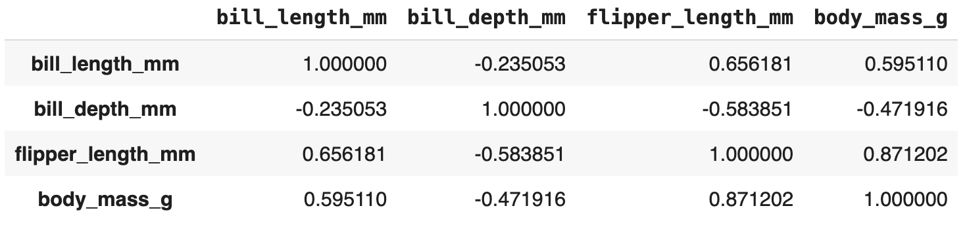
Multiivariate → many features
Heatmaps show correlation between all numerical features
num_penguins = penguins.select_dtypes(include = ['float64', 'int64'])
corr_matrix = num_penguins.corr()
sns.heatmap(corr_matrix, annot=True, cmap='magma', fmt='.2f', cbar=True)
numerical
numerical
numerical
take
note
requires interpretation and not great for small and/or sparse datasets

Slide 55
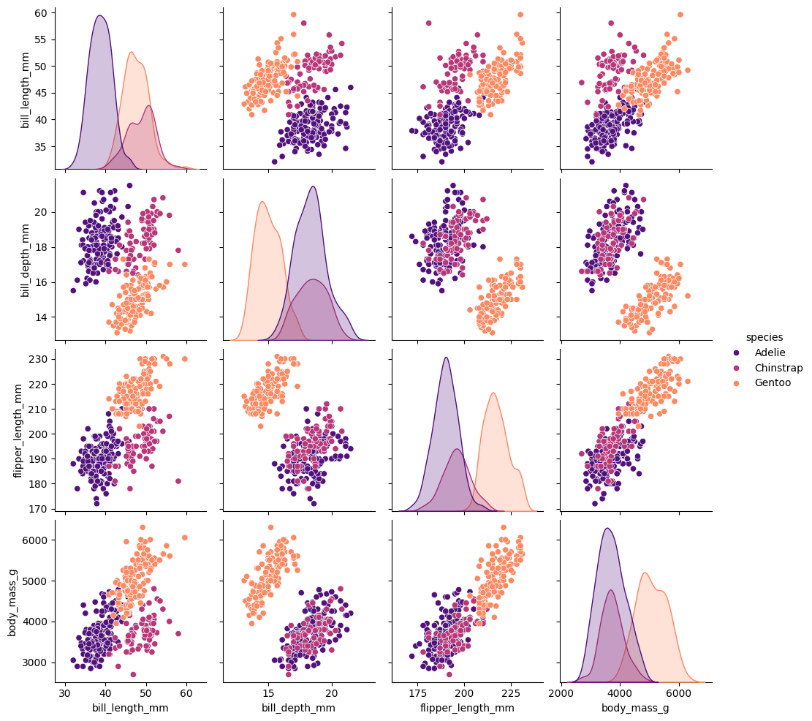
Multiivariate → many features
Pairplots show pairwise relationships between all numerical features
sns.pairplot(penguins, hue='species',palette='magma', dropna=True)
color by categorical feature
numerical
numerical
categorical
Typical to start here, then do some statistical tests or further visualizations
take
note
requires interpretation and not great for small and/or sparse datasets

Slide 56
Your turn!
Below are some pairings of features. Decide which chart type and/or summary would be best.
Once you have selected your charts, pick two to create.
Opening the slide deck in a new tab may be helpful.
set A
set B
island
flipper_length_mm
set E
set C
set D
island
flipper_length_mm
bill_length_mm
flipper_length_mm
bill_length_mm
island
bill_length_mm

Slide 57
Machine Learning
With python
PC 1
Three Datasets
Notes:
Layout objects pulled from: https://slidesgo.com/
All icons are from: https://thenounproject.com/

Slide 58

Identify three data sets that you’re interested in. Prioritize using the datasets listed in the project overview (see course site).
Post on the Forum under “Three datasets of interest”.
Include the following for each dataset selected: a link to a repo, a two sentence description, and the reasoning behind why you find that dataset interesting.
Keep this informal as I’m curious to see what types of datasets folks are interested in.
PC 1

Slide 59
lab work time
Lab1
View on our website

Slide 60
lab work time
Lab1
View on our website

